Slide 1


Spatial Analysis: A (not so) simple introduction
Muhammad Akmal Farouqi
05/6/2024
www.ugm.ac.id
Locally Rooted, Globally Respected

Slide 2
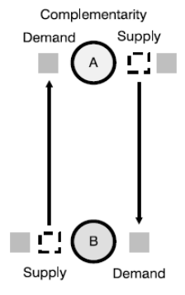
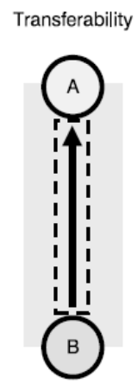
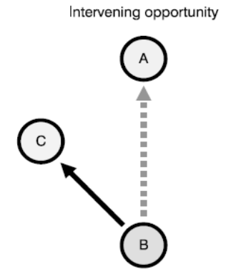
Spatial Interaction (Edward Ullman)
Ullman develops a fundamental concept of factors that lead to spatial interaction.
Complementarity
Transferability
Intervening Opportunity
There must be a supply and a demand between the interacting locations.
For instance, A residential zone is complementary to an industrial zone because the first is supplying workers while the second is supplying jobs.
Freight, persons or information being transferred must be supported by transport infrastructures, implying that the origin and the destination must be linked
Costs to overcome distance must not be higher than the benefits of related interaction, even if there is complementarity and no alternative opportunity
There must not be another location that may offer a better alternative as a point of origin or as a point of destination
If location C offers the same characteristics (namely complementarity) as location A and is also closer to location B, an interaction between B and A will not occur and replaced by an interaction between B and C.

Slide 3
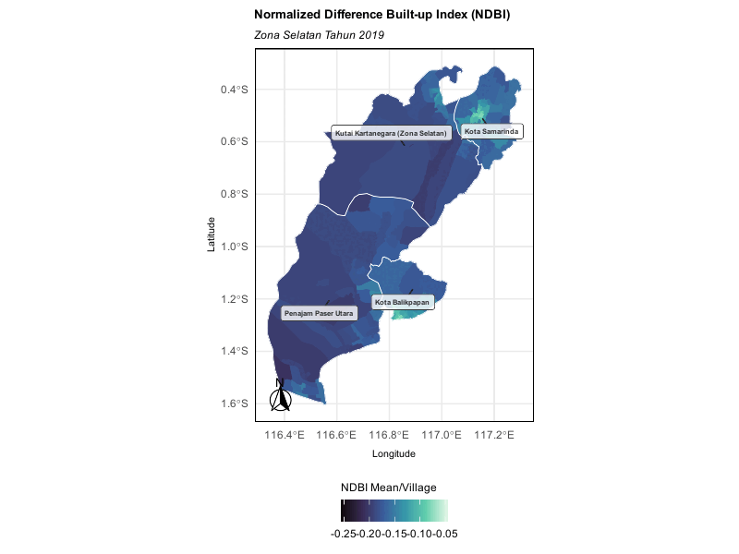
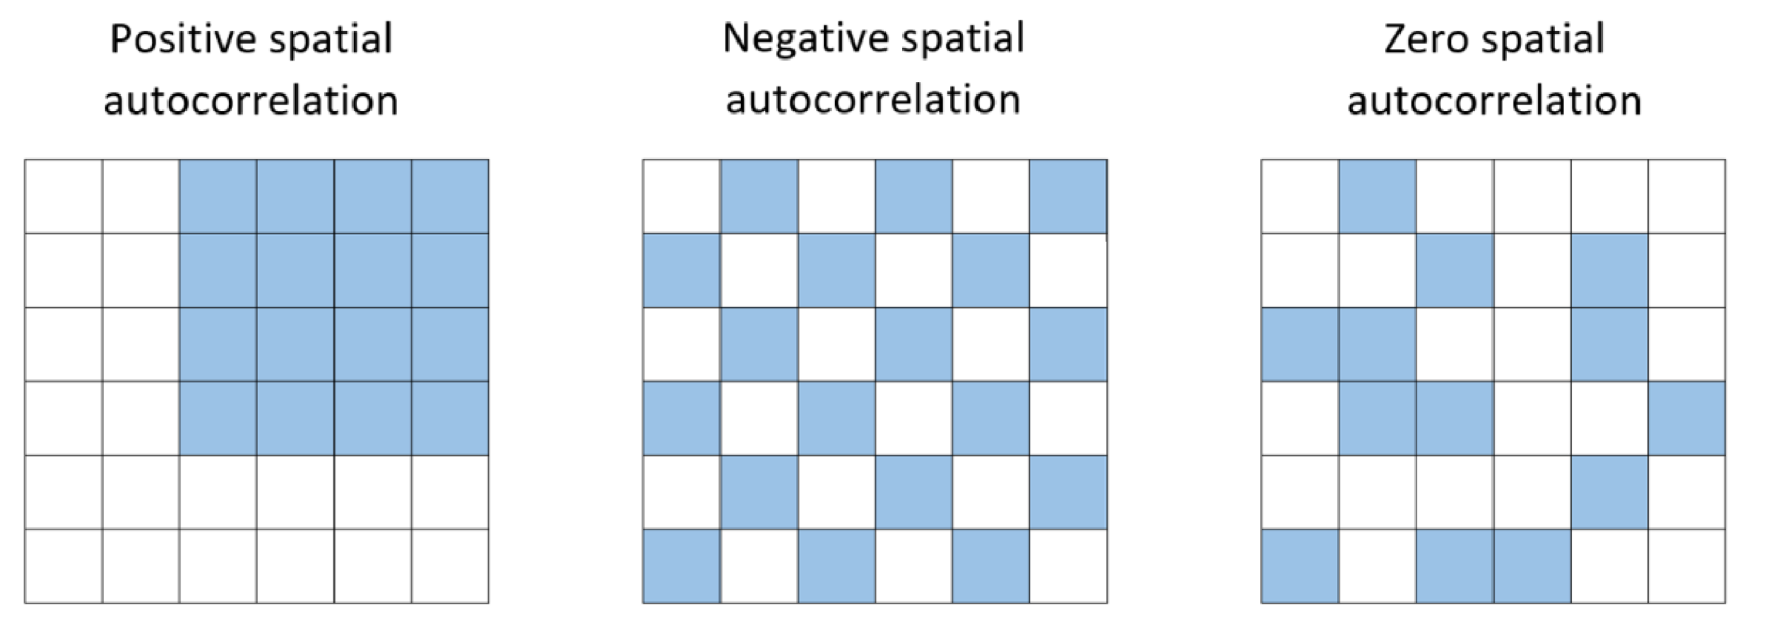
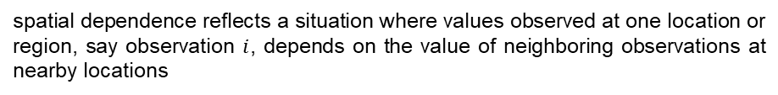
Spatial Dependence
“Everything is related to everything else, but near things are more related than distant things” – Tobler’s first law of geography
Look how the NDBI value of villages within Samarinda and Balikpapan seemed to be correlated with each other!
spatial dependence reflects a situation where values observed at one location or region, say observation $i$, depends on the value of neighboring observations at nearby locations
$$y_{i}=f\left(y_{j},x_{i}\right), j≠i$$

Slide 4
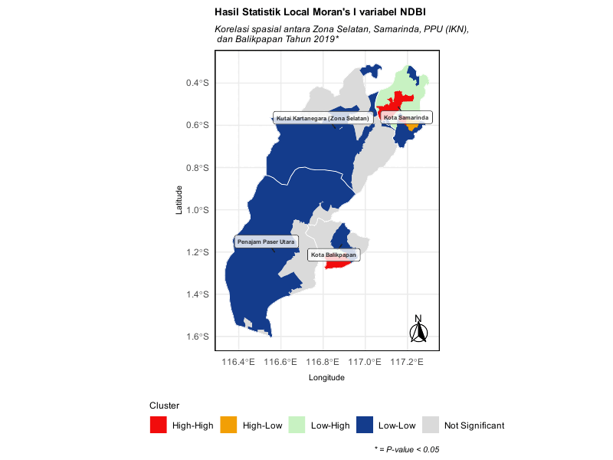
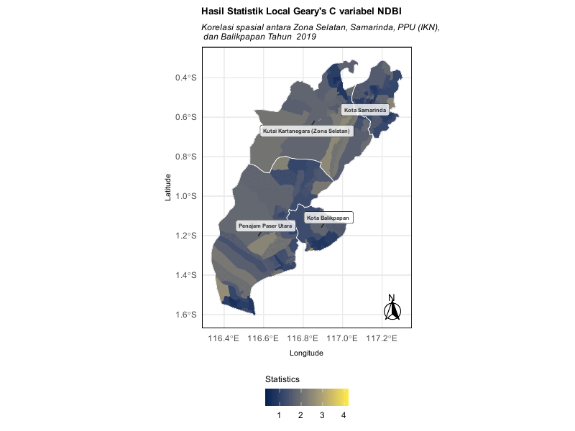
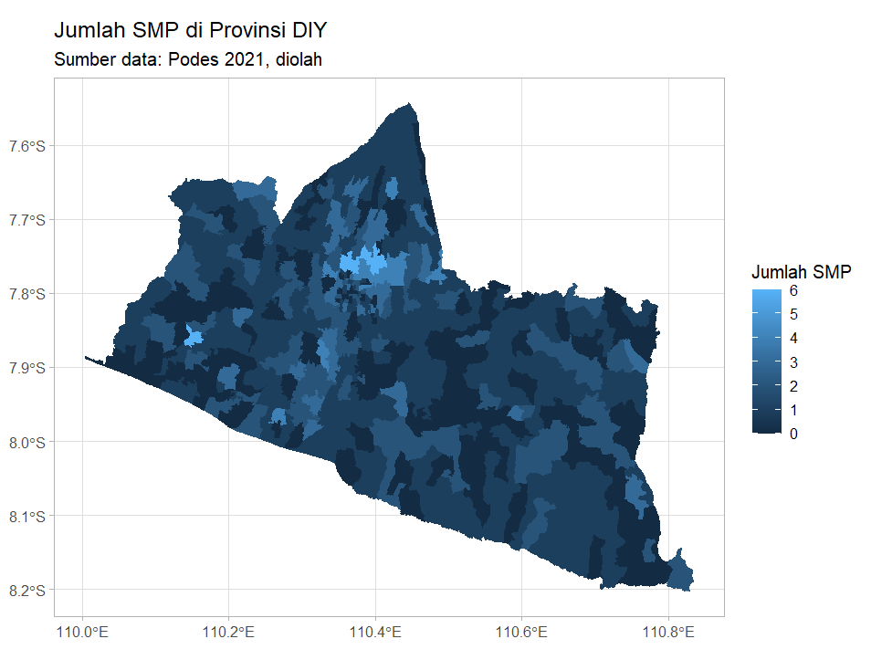
Spatial Dependence
Understanding the spatial behavior of a variable unlocks significant feature in our analysis! Especially, spatial distribution of an economic data.

Slide 5
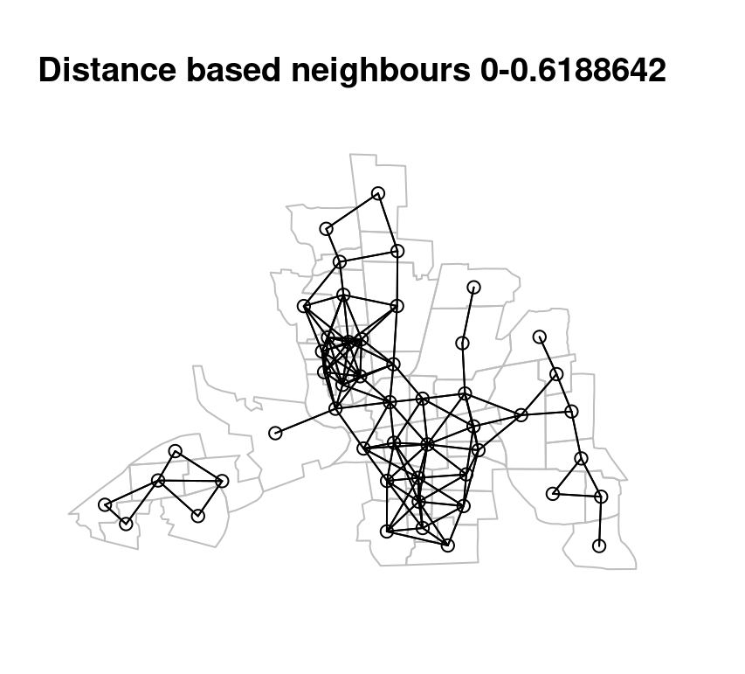
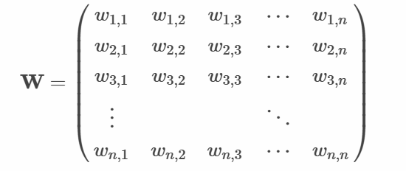
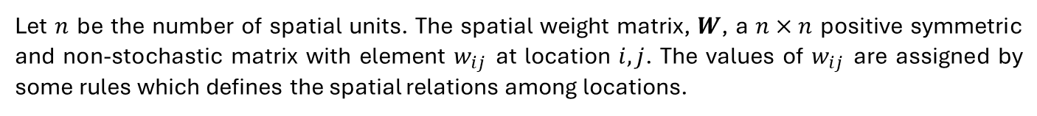

Neighbourhood System: Spatial Weight Matrix
Let $n$ be the number of spatial units. The spatial weight matrix, $W$, a $n×n$ positive symmetric and non-stochastic matrix with element $w_{ij}$ at location $i,j$. The values of $w_{ij}$ are assigned by some rules which defines the spatial relations among locations.
$w=0$ for the diagonal elements

Slide 6
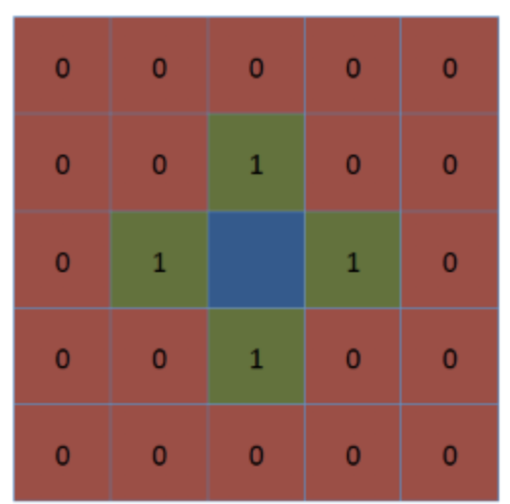
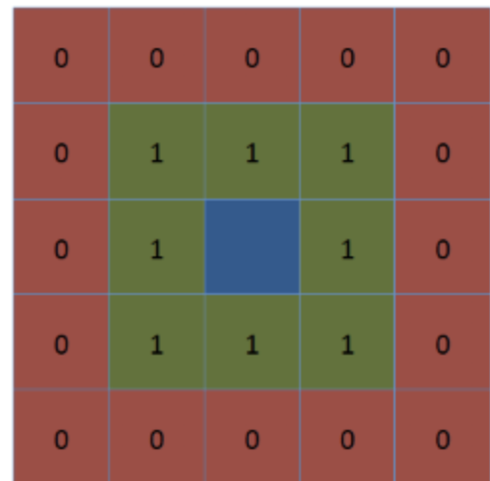
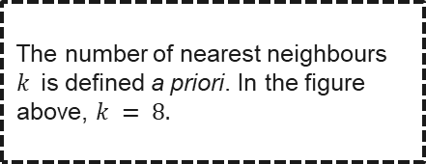
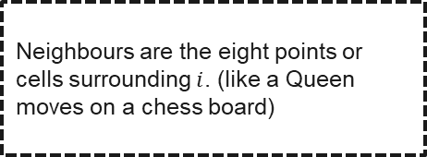
Neighbourhood System: Contiguity-based
Neighbourhood is a set of spatial units that are considered “close” to a given unit. neighbourhood system refers to a formal way of defining which spatial units are considered “neighbours” to each other. This is crucial to assess spatial autocorrelation and find out whether close areas have similar or dissimilar values.
Rook
Queen
Nearest Neighbours
Neighbours are the four adjacent locations identified by 1’s and others are represented in 0
(like Rook moves on a chess board)
Neighbours are the eight points or cells surrounding $i$. (like a Queen moves on a chess board)
The number of nearest neighbours $k$is defined a priori. In the figure above, $k = 8.$

Slide 7
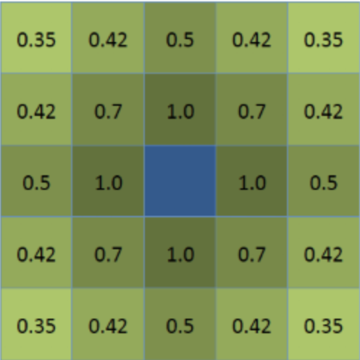
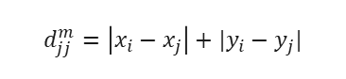
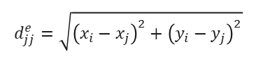
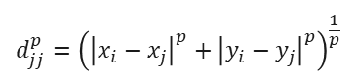

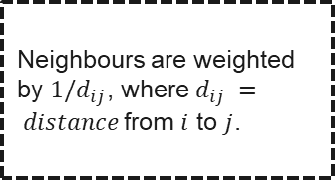
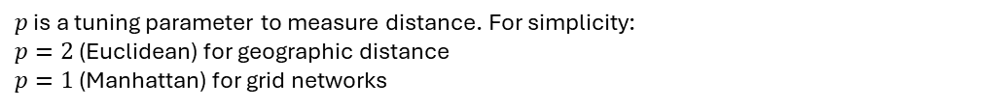
Neighbourhood System: Distance-based
Neighbourhood is a set of spatial units that are considered “close” to a given unit. neighbourhood system refers to a formal way of defining which spatial units are considered “neighbours” to each other. This is crucial to assess spatial autocorrelation and find out whether close areas have similar or dissimilar values.
Inverse Distance
How actually distance is measured?
Let $x_{i}$ and $x_{j}$ be the longitude and $y_{i}$ and $y_{j}$ the latitude coordinates for region $i$ and $j$
Minkowski metric
Euclidean metric
Manhattan metric
$$d_{jj}^{p}={\left({\left|x_{i}−x_{j}\right|}^{p}+{\left|y_{i}−y_{j}\right|}^{p}\right)}^{\frac{1}{p}}$$
$$d_{jj}^{e}=\sqrt{{\left(x_{i}−x_{j}\right)}^{2}+{\left(y_{i}−y_{j}\right)}^{2}}$$
$$d_{jj}^{m}=\left|x_{i}−x_{j}\right|+|y_{i}−y_{j}|$$
$p$ is a tuning parameter to measure distance. For simplicity:
$p=2$ (Euclidean) for geographic distance
$p=1$ (Manhattan) for grid networks
Neighbours are weighted by $1/d_{ij}$, where $d_{ij} = distance$from $i$ to $j$.
Choice of points (to measure $i$ to $j$) is potentially significant and requires theoretical justification. Oftentimes people use the centroids, while sometimes they use the CBD or district’s capital area)

Slide 8
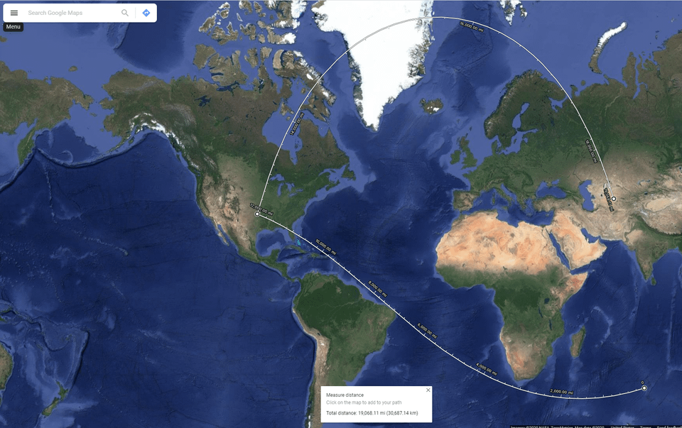
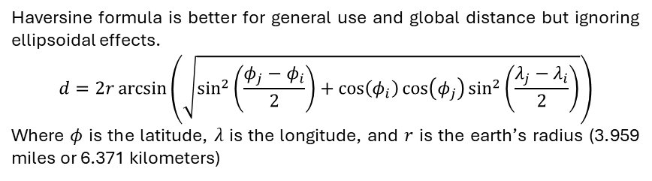
Neighbourhood System: Distance-based
Euclidean distance is not necessarily the shortest distance if you take into account the curvature of the earth.
Great Circle Distance
Some Measurements
Unlike Euclidean distance, which assumes flat space, great-circle distance follows the curvature of the Earth.
Haversine
Haversine formula is better for general use and global distance but ignoring ellipsoidal effects.
$$d=2r\arcsin\left(\sqrt{\sin^{2}\left(\frac{φ_{j}−φ_{i}}{2}\right)+\cos\left(φ_{i}\right)\cos\left(φ_{j}\right)\sin^{2}\left(\frac{λ_{j}−λ_{i}}{2}\right)}\right)$$
Where $φ$ is the latitude, $λ$ is the longitude, and $r$ is the earth’s radius (3.959 miles or 6.371 kilometers)
Geodetic
Highly accurate estimate of the shortest distance between two points on an ellipsoid (default is WGS84 ellipsoid). Ellipsoid parameter can be from GRS80, Krasovsky 1940, International 1924, etc.
Euclidean distance assumes flat space.
Geographic coordinates (latitude & longitude) are angular, not Cartesian.
Using Euclidean distance on them introduces large errors, especially near poles or over long distances.
Vincenty (Ellipsoid)
Accommodating both great-circled method and ellipsoid, but computationally more intensive.

Slide 9
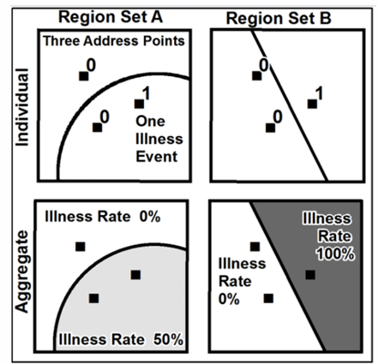

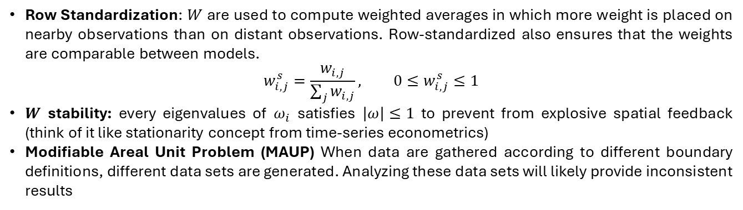
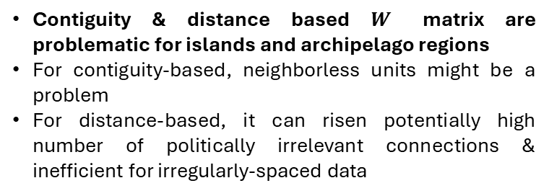
Neighbourhood System: Row standardization
Row Standardization: $W$ are used to compute weighted averages in which more weight is placed on nearby observations than on distant observations. Row-standardized also ensures that the weights are comparable between models.
$$w_{i,j}^{s}=\frac{w_{i,j}}{\sum_{j}{w_{i,j}}}, 0≤w_{i,j}^{s}≤1$$
$W$ stability: every eigenvalues of $ω_{i}$ satisfies $\left|ω\right|≤1$ to prevent from explosive spatial feedback (think of it like stationarity concept from time-series econometrics)
Modifiable Areal Unit Problem (MAUP) When data are gathered according to different boundary definitions, different data sets are generated. Analyzing these data sets will likely provide inconsistent results
Some drawbacks:
Contiguity & distance based $W$ matrix are problematic for islands and archipelago regions
For contiguity-based, neighborless units might be a problem
For distance-based, it can risen potentially high number of politically irrelevant connections & inefficient for irregularly-spaced data

Slide 10
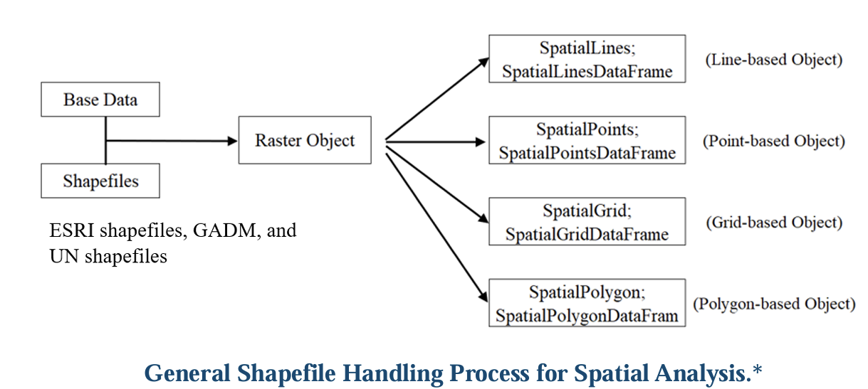
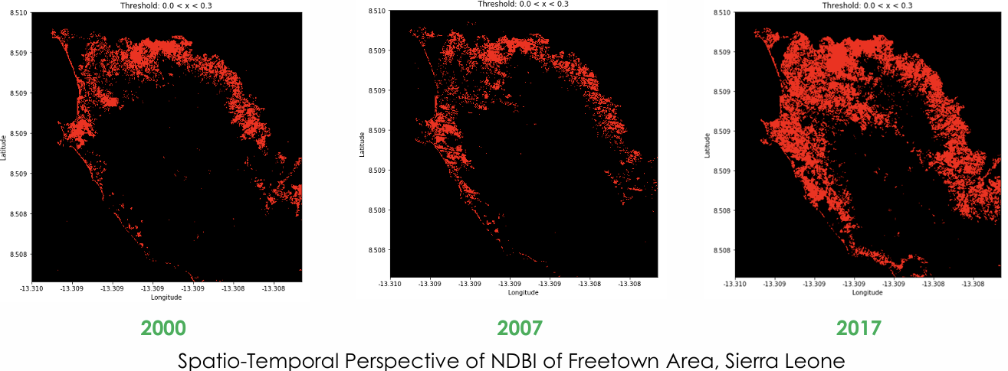
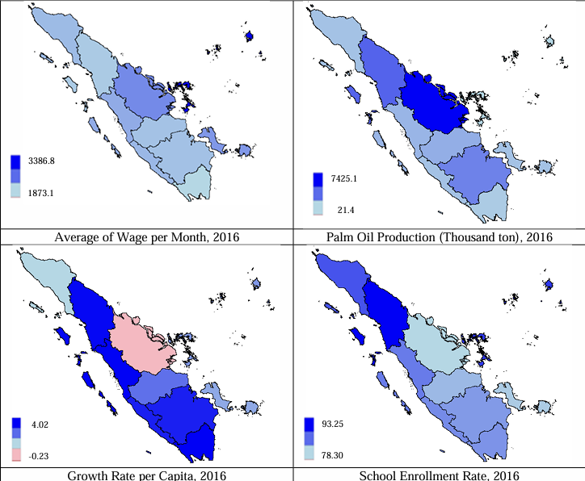
Spatial Data
Lattice data (Grid-cell data)
Handling spatial data
Some spatial data sources:
SHP Indonesia: ESRI
Climate data: NASA
Other (land use, NTL, etc): link.
Non-Lattice data

Slide 11
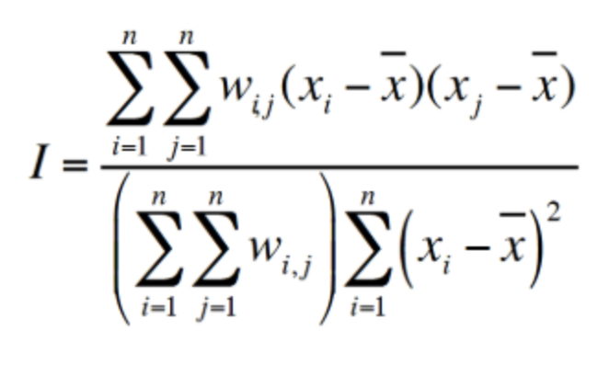
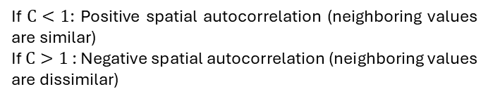
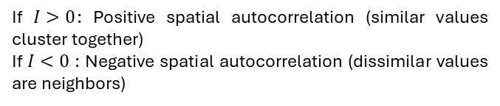
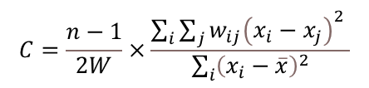
Detecting Spatial Autocorrelation: Global
Global spatial autocorrelation measures whether similar values (e.g., high or low) tend to cluster together across an entire study area. In other words, detecting the presence of spatial autocorrelation across the sample. Common indicators used are Moran’s I and Geary’s C
Moran’s I
Geary’s C
An area, globally, exhibits perfect clustering if the value approaches 1, dispersion if it approaches -1, and is considered random (no clusters found in the observed data) if it approaches 0.
The results of the Global Geary’s C analysis can be interpreted as having positive spatial correlation when the value approaches 0, negative correlation when the value moves further away from 1, and no spatial autocorrelation when it approaches 1.
$$C=\frac{n−1}{2W}×\frac{\sum_{i}{\sum_{j}{w_{ij}{\left(x_{i}−x_{j}\right)}^{2} }}}{\sum_{i}{{\left(x_{i}−\overline{x}\right)}^{2}}}$$
If $I>0$: Positive spatial autocorrelation (similar values cluster together)
If $I<0$ : Negative spatial autocorrelation (dissimilar values are neighbors)
If $C<1$: Positive spatial autocorrelation (neighboring values are similar)
If $C>1$ : Negative spatial autocorrelation (neighboring values are dissimilar)

Slide 12
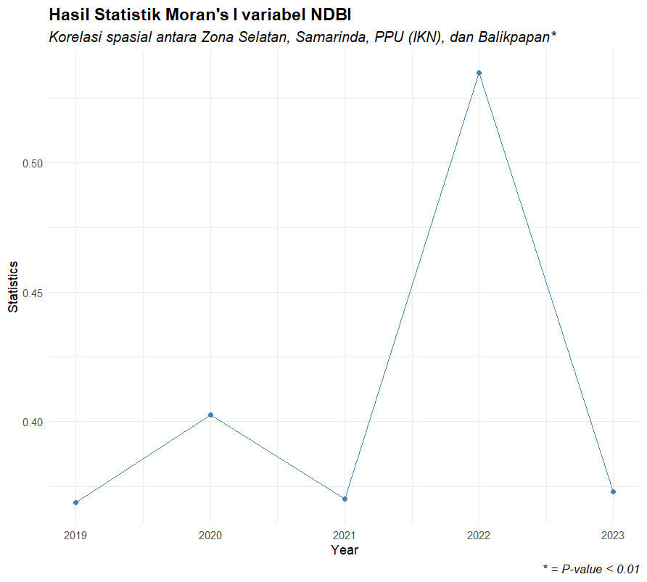
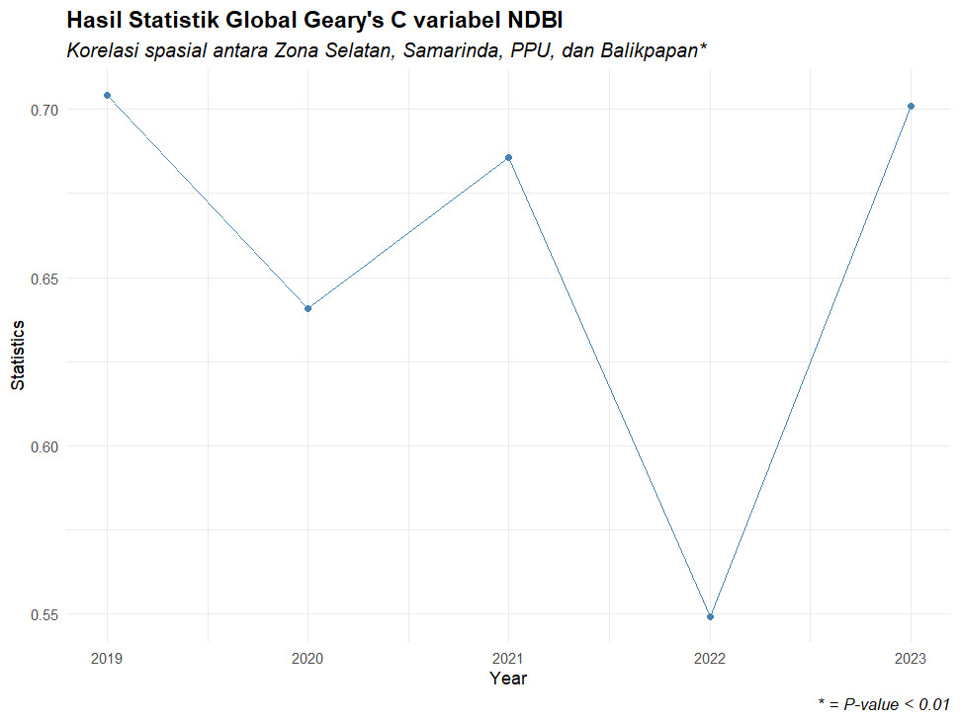
Detecting Spatial Autocorrelation: Global
Global spatial autocorrelation measures whether similar values (e.g., high or low) tend to cluster together across an entire study area. In other words, detecting the presence of spatial autocorrelation across the sample. Common indicators used are Moran’s I and Geary’s C
Moran’s I
Geary’s C

Slide 13
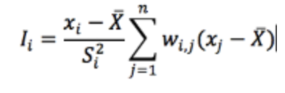
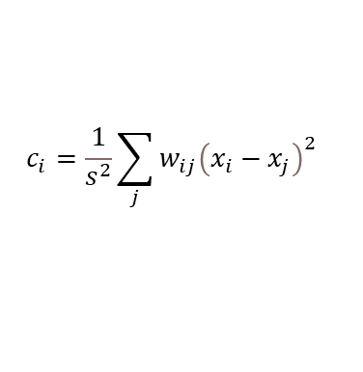
Detecting Spatial Autocorrelation: Local
Local spatial autocorrelation analysis identifies spatial patterns at the local level, highlighting where clusters or outliers occur within a study area
Moran’s I
Geary’s C
Local Moran’s I aims to capture similarity with the entire sample, allowing it to detect clusters or outliers and provide indications of hotspots within the sample area. The results of the Local Moran’s I analysis are displayed in five categories: High-High, High-Low, Low-High, Low-Low, and Not Significant.
Local Geary’s C takes a more micro-level perspective, placing greater emphasis on calculations involving neighboring areas rather than the entire sample. This allows it to more sensitively detect local heterogeneity or homogeneity.
$$c_{i}=\frac{1}{s^{2}}\sum_{j}{w_{ij}{\left(x_{i}−x_{j}\right)}^{2}}$$
High-High | cluster of areas with high development levels (a hotspot).
High-Low | condition where an area has significantly high development, but its neighboring areas do not.
Low-High | is the opposite of High-Low — the area itself has low development, even though it is surrounded by areas with high development.
Low-Low | Is the opposite of High-High — it indicates a positive cluster of areas, all experiencing low levels of development.
The results of Local Geary’s C are represented as numerical values, where smaller values indicate weaker spatial association or connection with neighboring areas, and larger values indicate stronger similarity

Slide 14
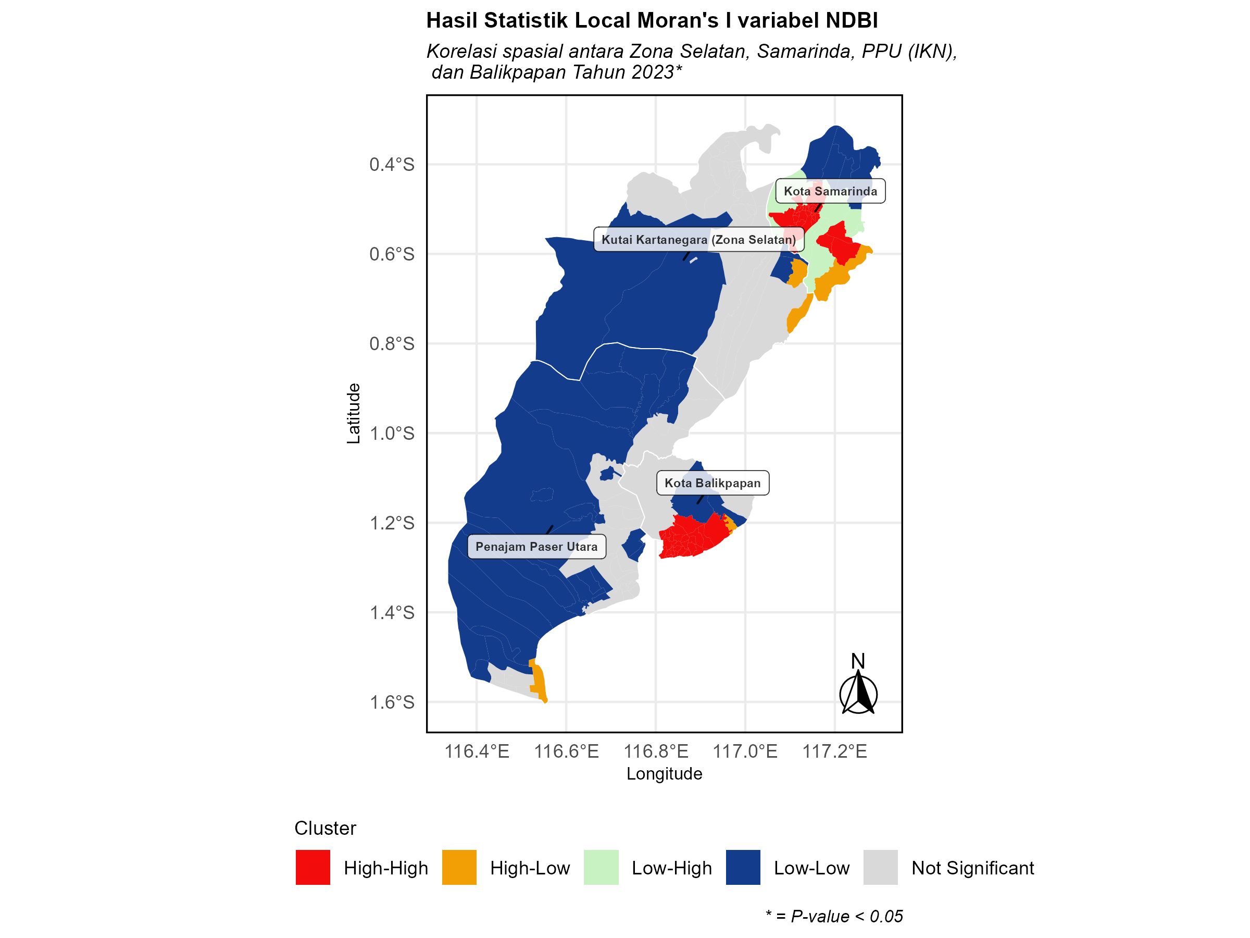
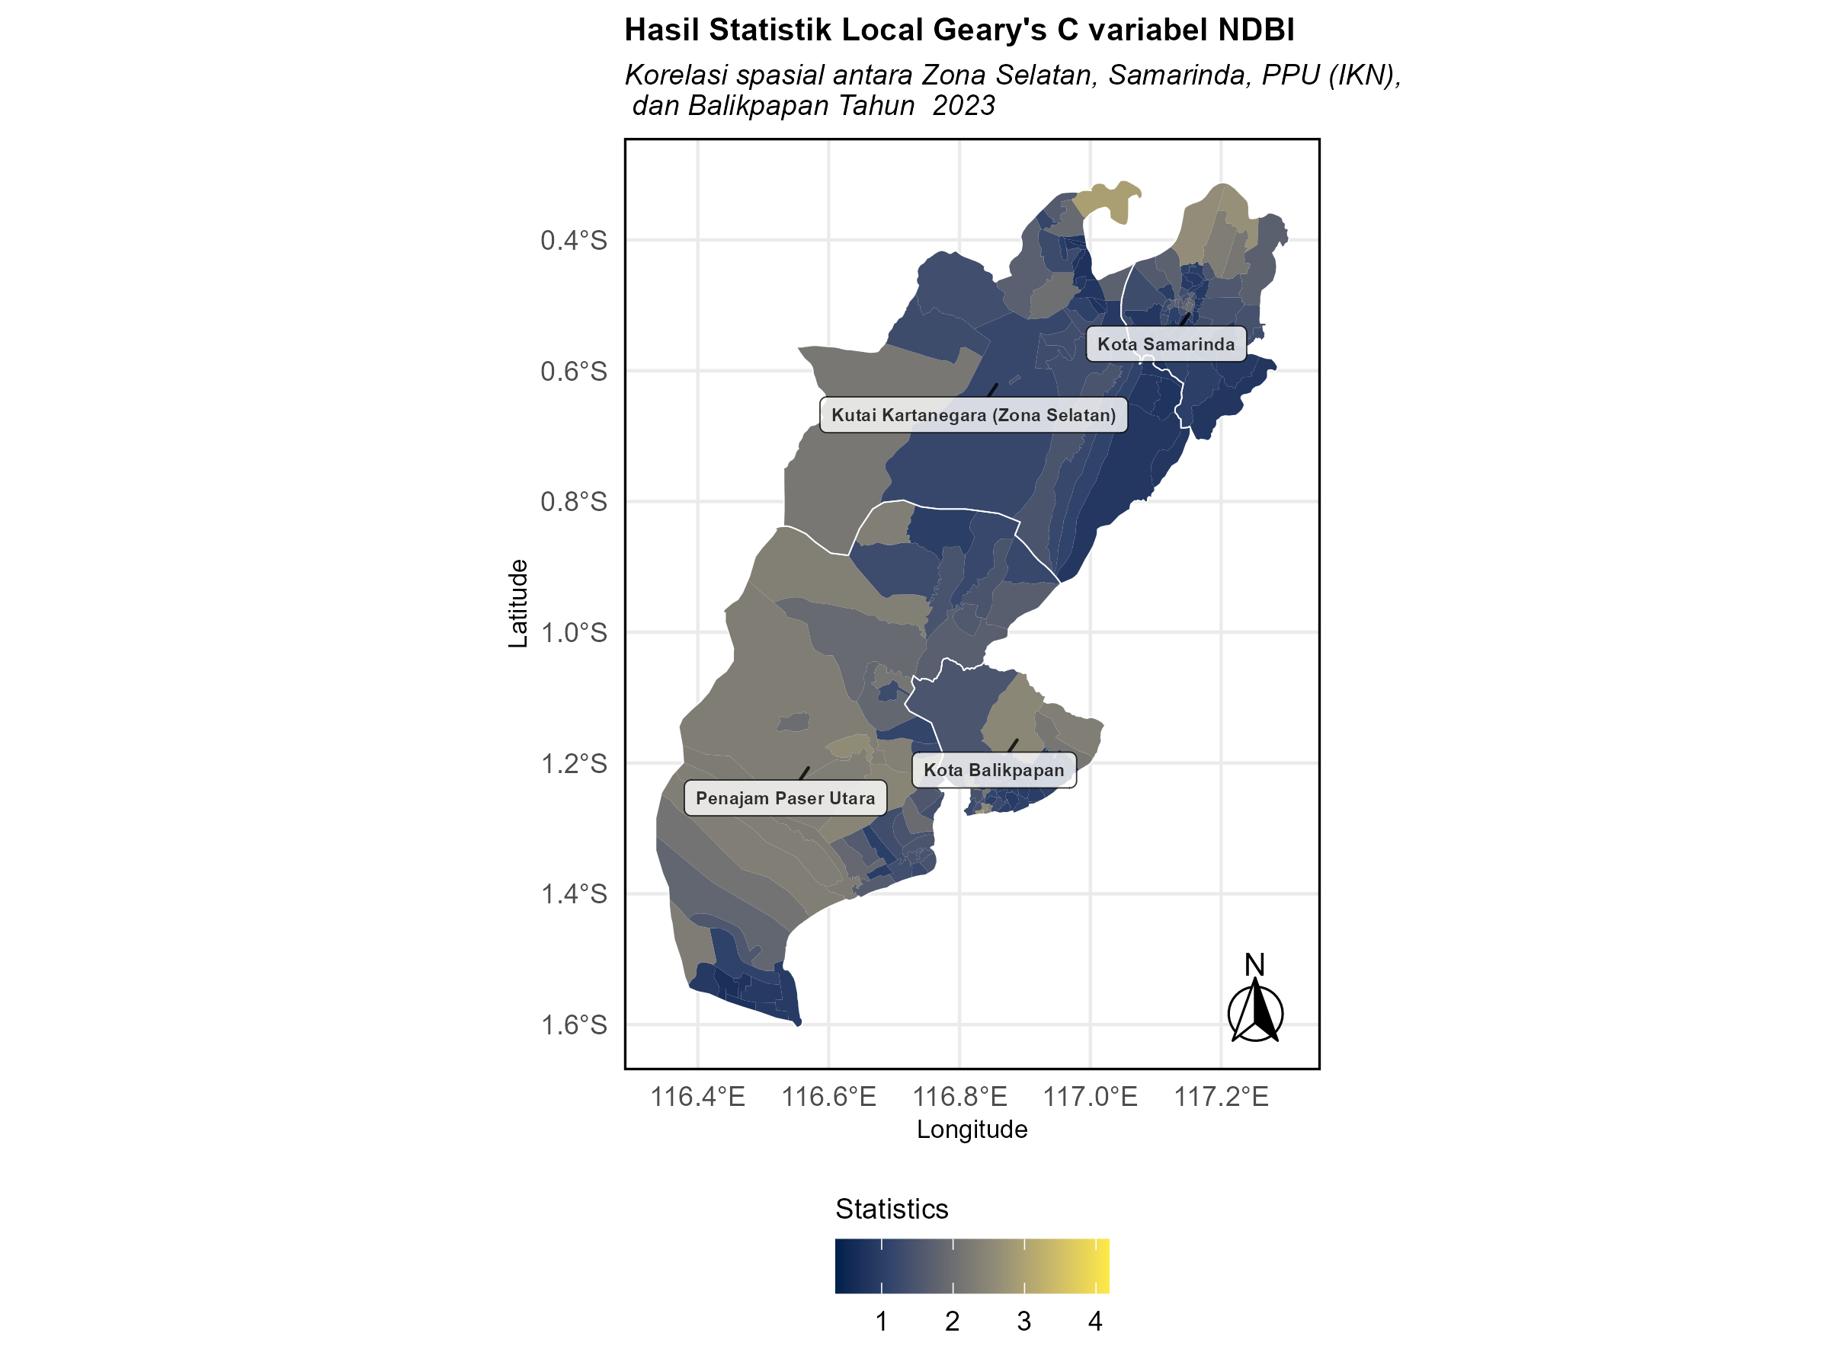
Detecting Spatial Autocorrelation: Local
Local spatial autocorrelation analysis identifies spatial patterns at the local level, highlighting where clusters or outliers occur within a study area
Moran’s I
Geary’s C

Slide 15
Spatial Econometrics

Slide 16
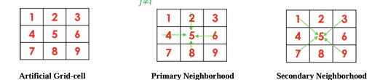
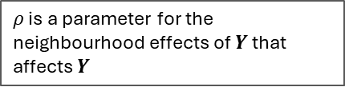
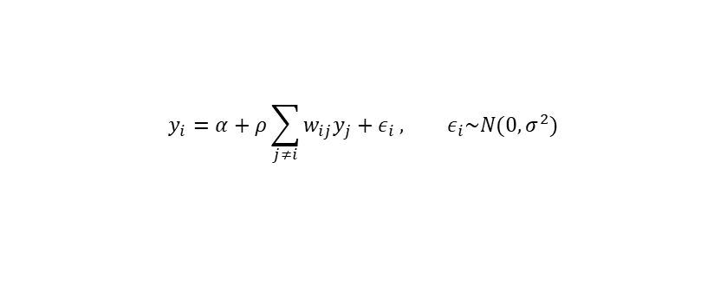
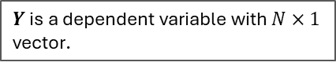
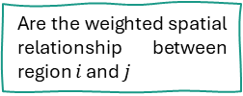
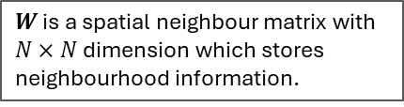
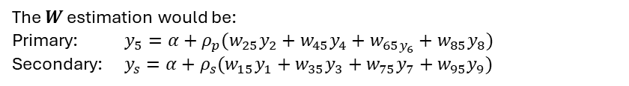
Model Configuration
Spatial econometrics is a subdiscipline of econometrics that handles spatial autocorrelation and spatial heterogeneity in regression models. Spatial econometrics can be performed in multiple data settings: (1) Cross-section or panel data, (2) non-dynamic and dynamic model.
The intuition of the $W$ is quite straightforward:
A simple spatial econometrics model can be described as follows:
The $W$ estimation would be:
Primary: $y_{5}=α+ρ_{p}(w_{25}y_{2}+w_{45}y_{4}+w_{65y_{6}}+w_{85}y_{8})$
Secondary: $y_{s}=α+ρ_{s}(w_{15}y_{1}+w_{35}y_{3}+w_{75}y_{7}+w_{95}y_{9})$
Are the weighted spatial relationship between region $i$ and $j$
$$Y=α+ρWY+ε, ε\sim N(0,σ^{2}I)$$
$W$ is a spatial neighbour matrix with $N×N$ dimension which stores neighbourhood information.
$$y_{i}=α+ρ\sum_{j≠i}{w_{ij}y_{j}+ε_{i}}, ε_{i}\sim N(0,σ^{2})$$
$ρ$ is a parameter for the neighbourhood effects of $Y$ that affects $Y$
$$Y=α+ρWY+ε, ε\sim N(0,σ^{2}I)$$
$Y$ is a dependent variable with $N×1$ vector.

Slide 17
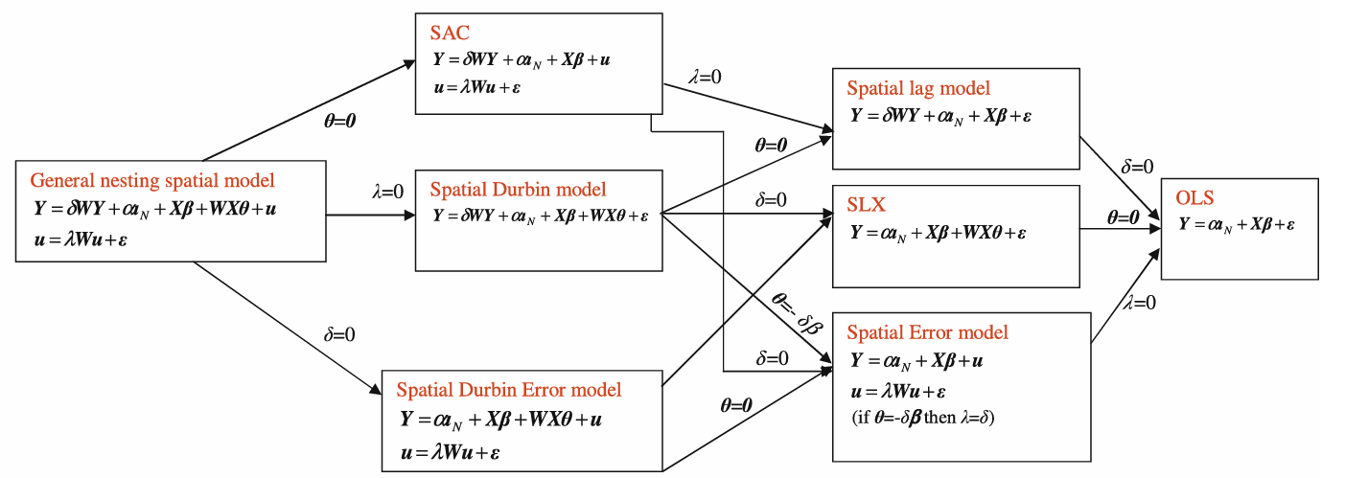
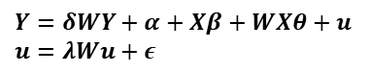
Family of Spatial Econometrics Model
In reality, spatial effects might be detected other than the dependent variable, such as $WX$, the error $Wε$, or the combination of them. The general spatial econometric model, called General Nesting Spatial Model, can be constructed as below:
$Y=δWY+α+Xβ+WXθ+u$
$u=λWu+ε$
$δ$ = spatial autoregressive coefficient, $λ=$ spatial autocorrelation coefficient, $θ$ = represents spatial coefficient of the explanatory variables.
Sometimes, GNS is called Manski Model & SAC is Kalejian-Prucha Model

Slide 18
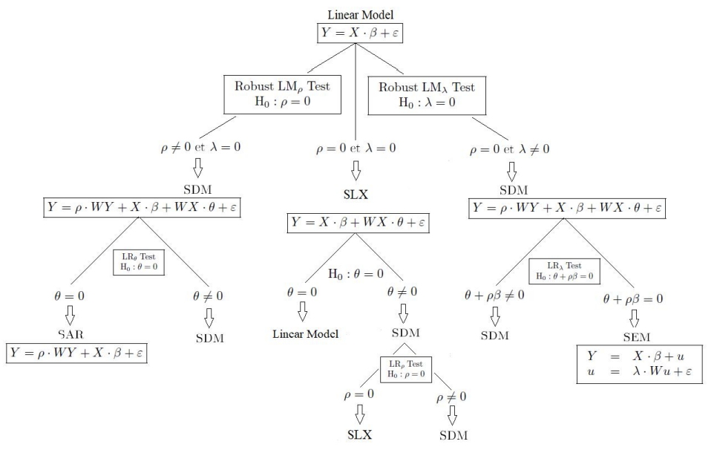
Model Selection (Elhorst, 2010)

Slide 19
Thank You

